Slide 1
Homework 1

Slide 2
Given the following class GradeBook Kindly give a detailed description for each part of the following code. Identify the static and instance members of the class. And explain in detail the reason for using set and get methods. Explanation should be from your point-of-view.
Finally, implement the code and attach clear screenshots from your code and output. And explain the output too.

Slide 3
1.6 Case Study: Class GradeBook Using an Array to Store Grades
We now present the first part of our case study on developing a GradeBook class that instructors can use to maintain students’ grades on an exam and display a grade report that includes the grades, class average, lowest grade, highest grade and a grade distribution bar chart.
The version of class GradeBook presented in this section stores the grades for one exam in a one-dimensional array.
Assignment: implement a version of class GradeBook that uses a two-dimensional array to store students’ grades for several exams.

Slide 4
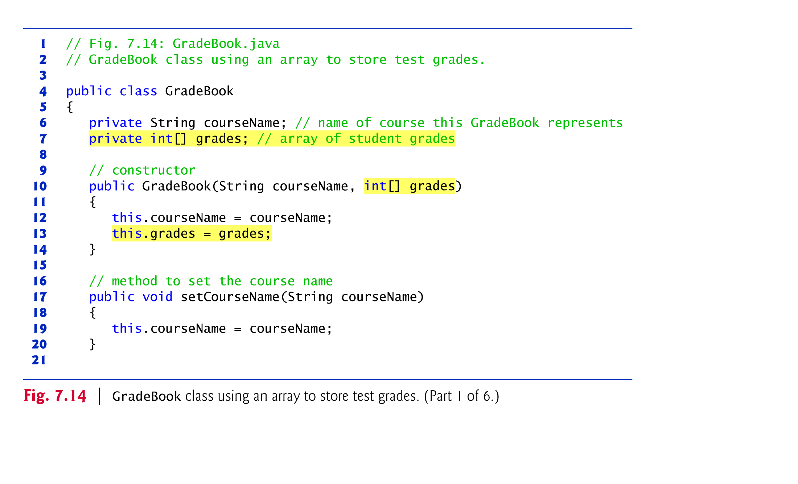

Slide 5
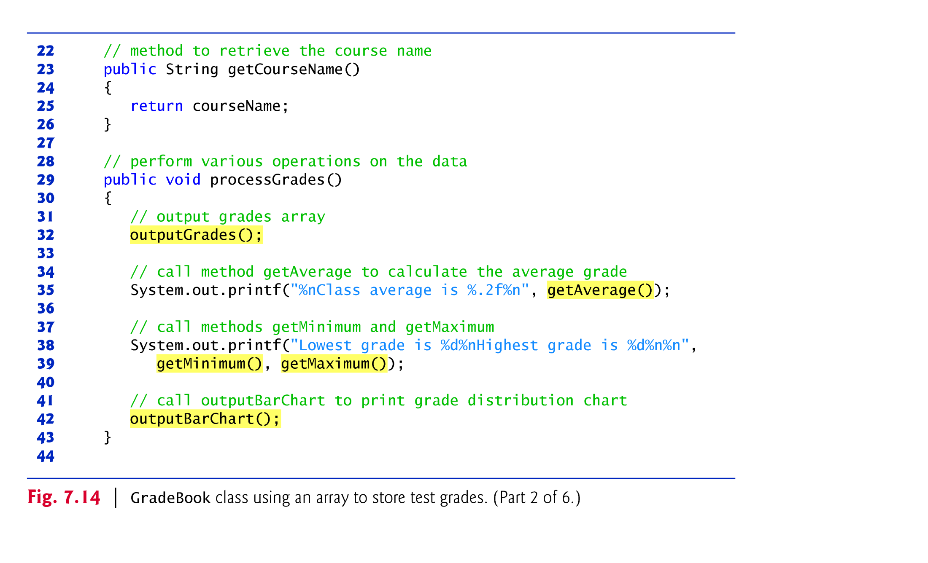

Slide 6
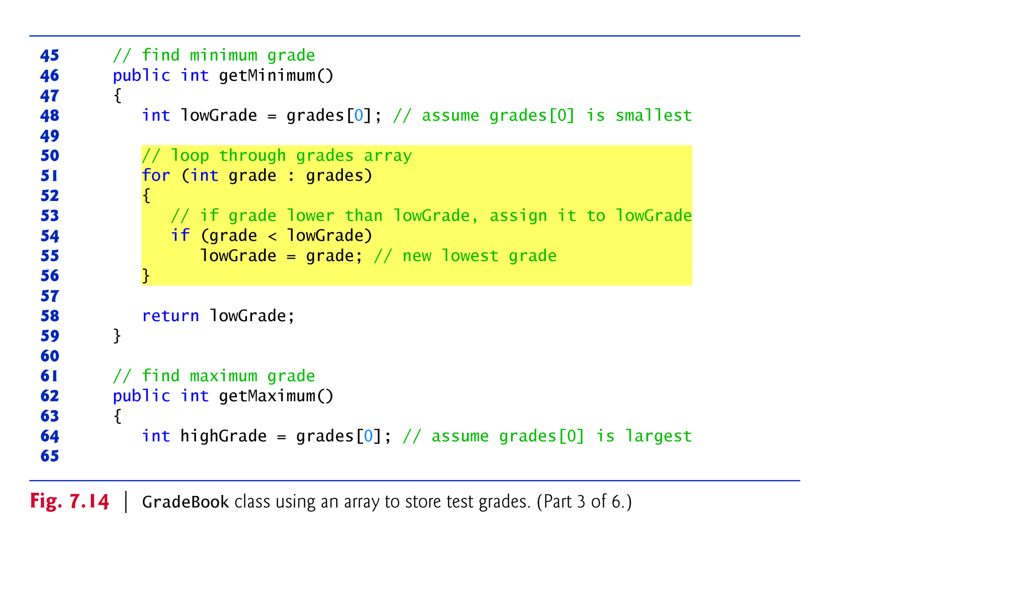

Slide 7
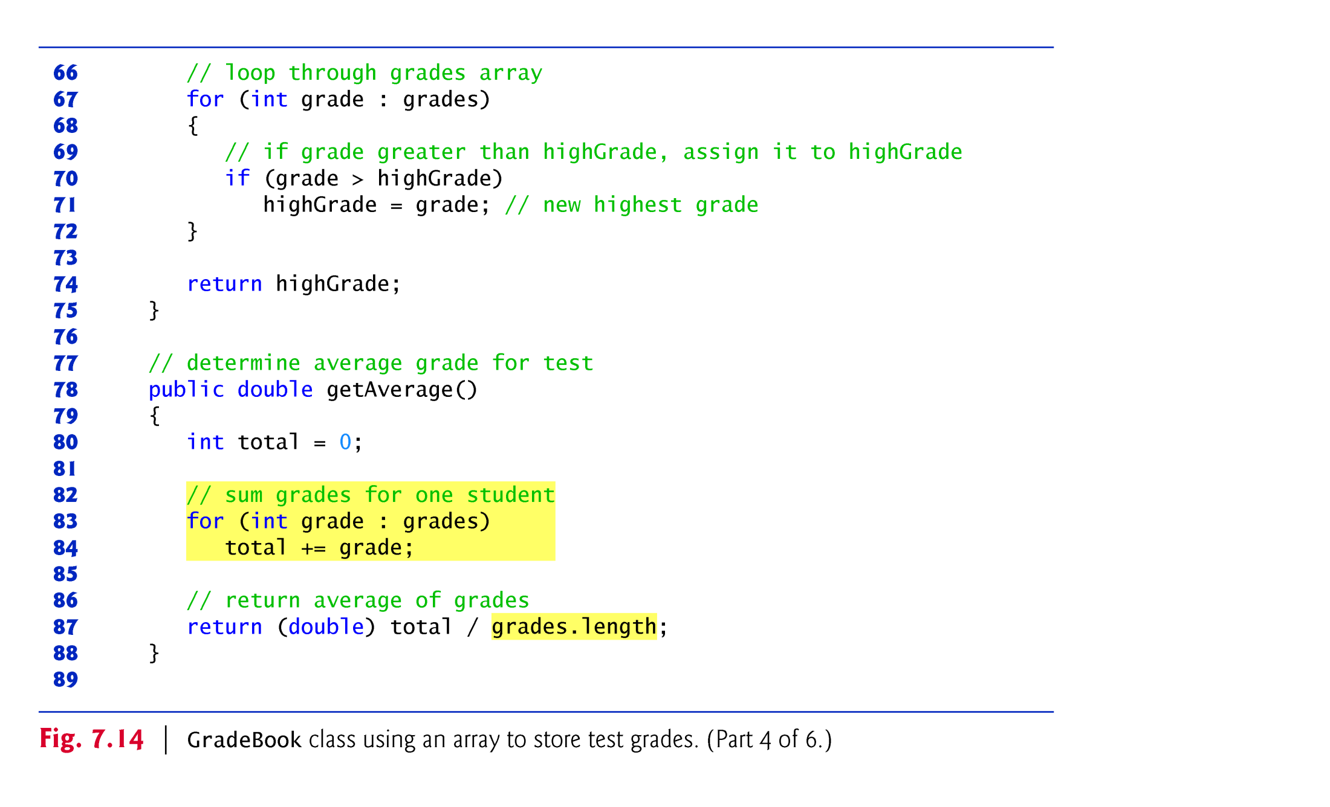

Slide 8
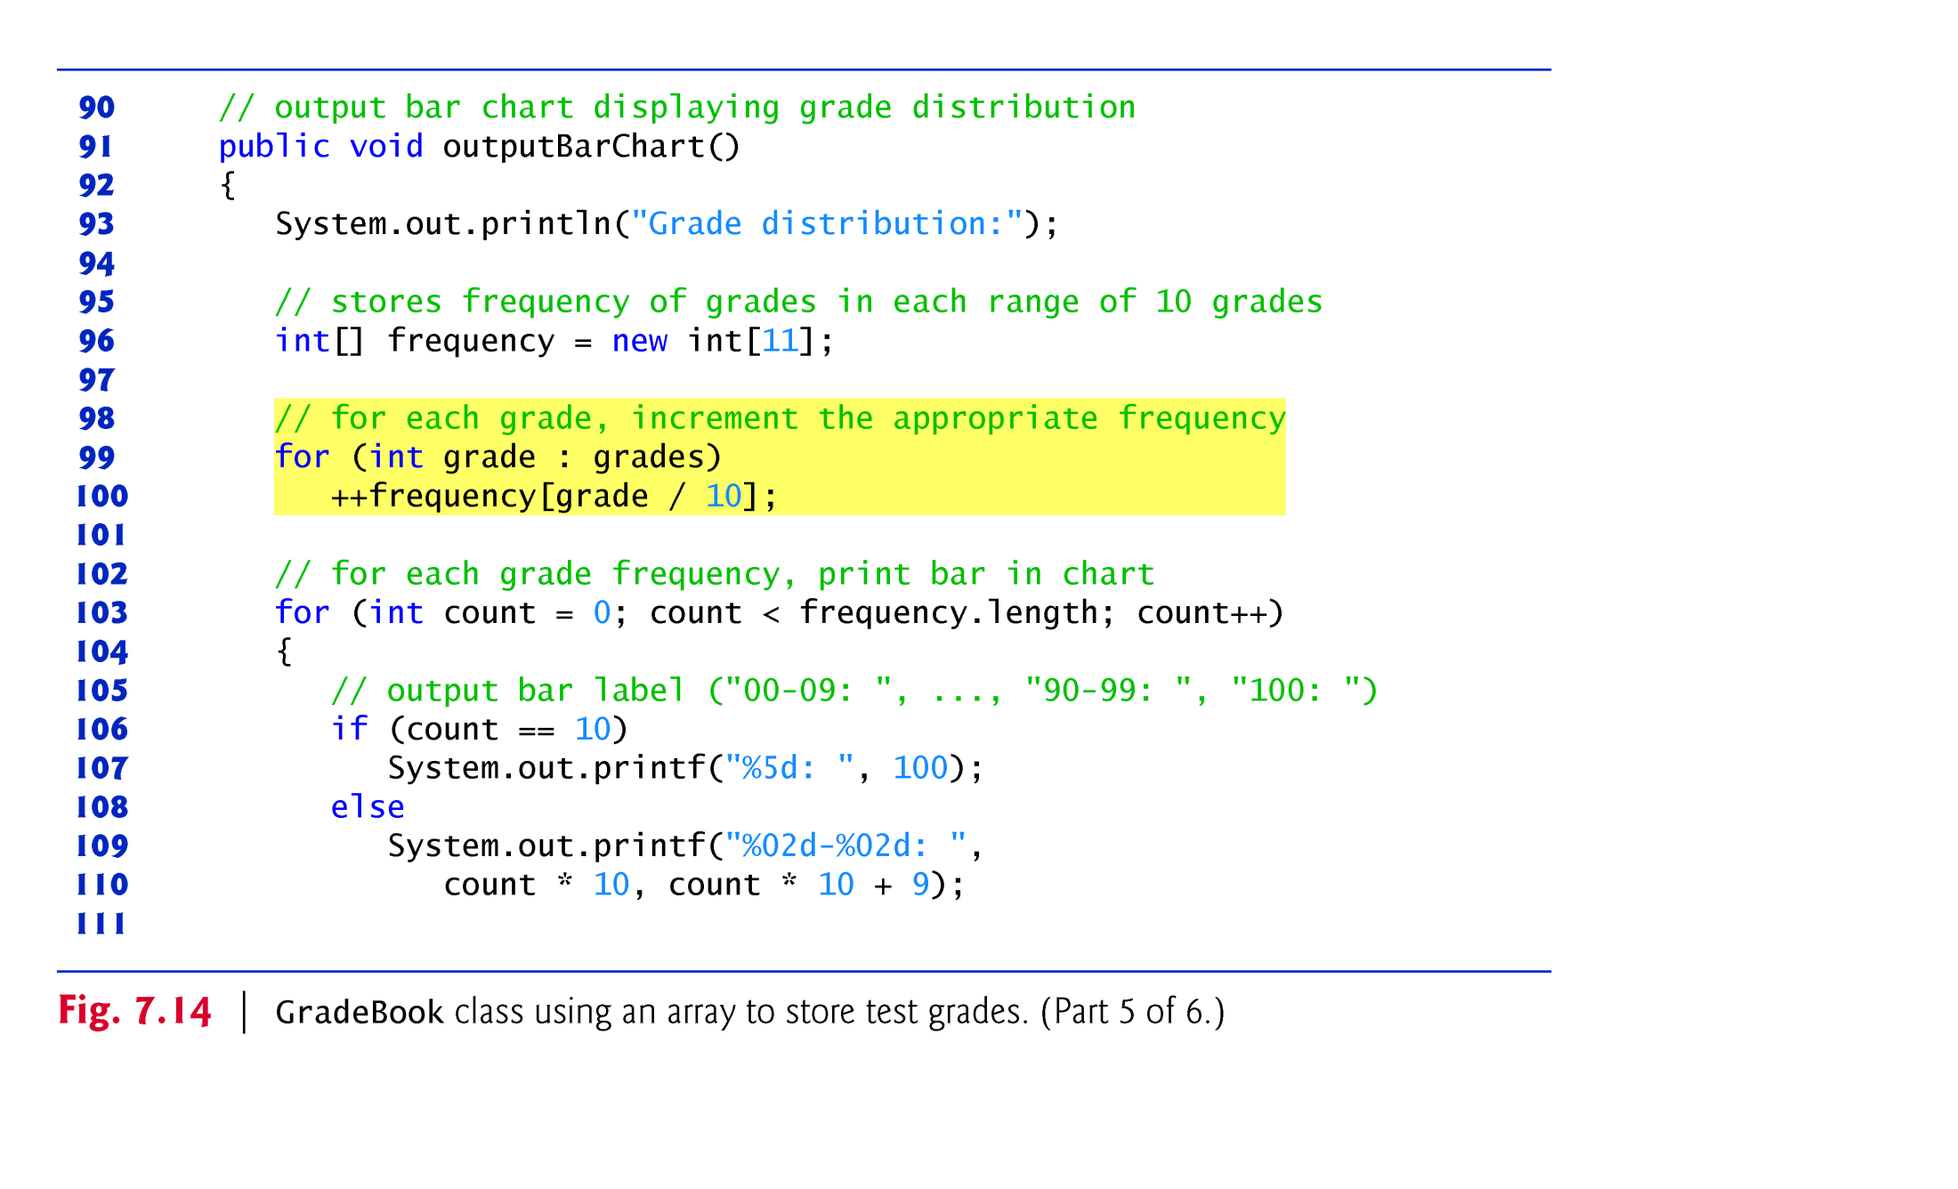

Slide 9
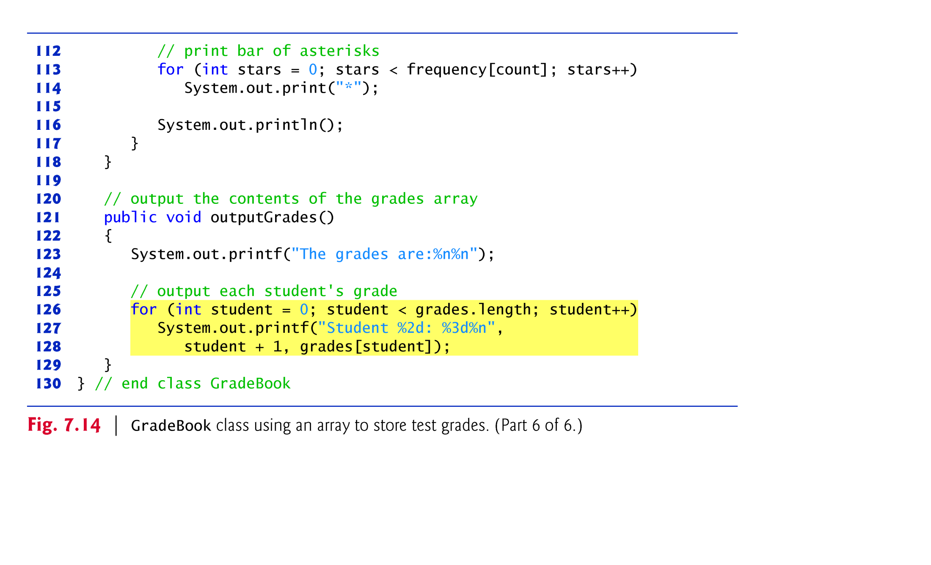

Slide 10
1.6 Case Study: Class GradeBook Using an Array to Store Grades (Cont.)
The application of Fig. 7.15 creates an object of class GradeBook (Fig. 7.14) using the int array grades-Array.
Lines 12–13 pass a course name and gradesArray to the GradeBook constructor.

Slide 11
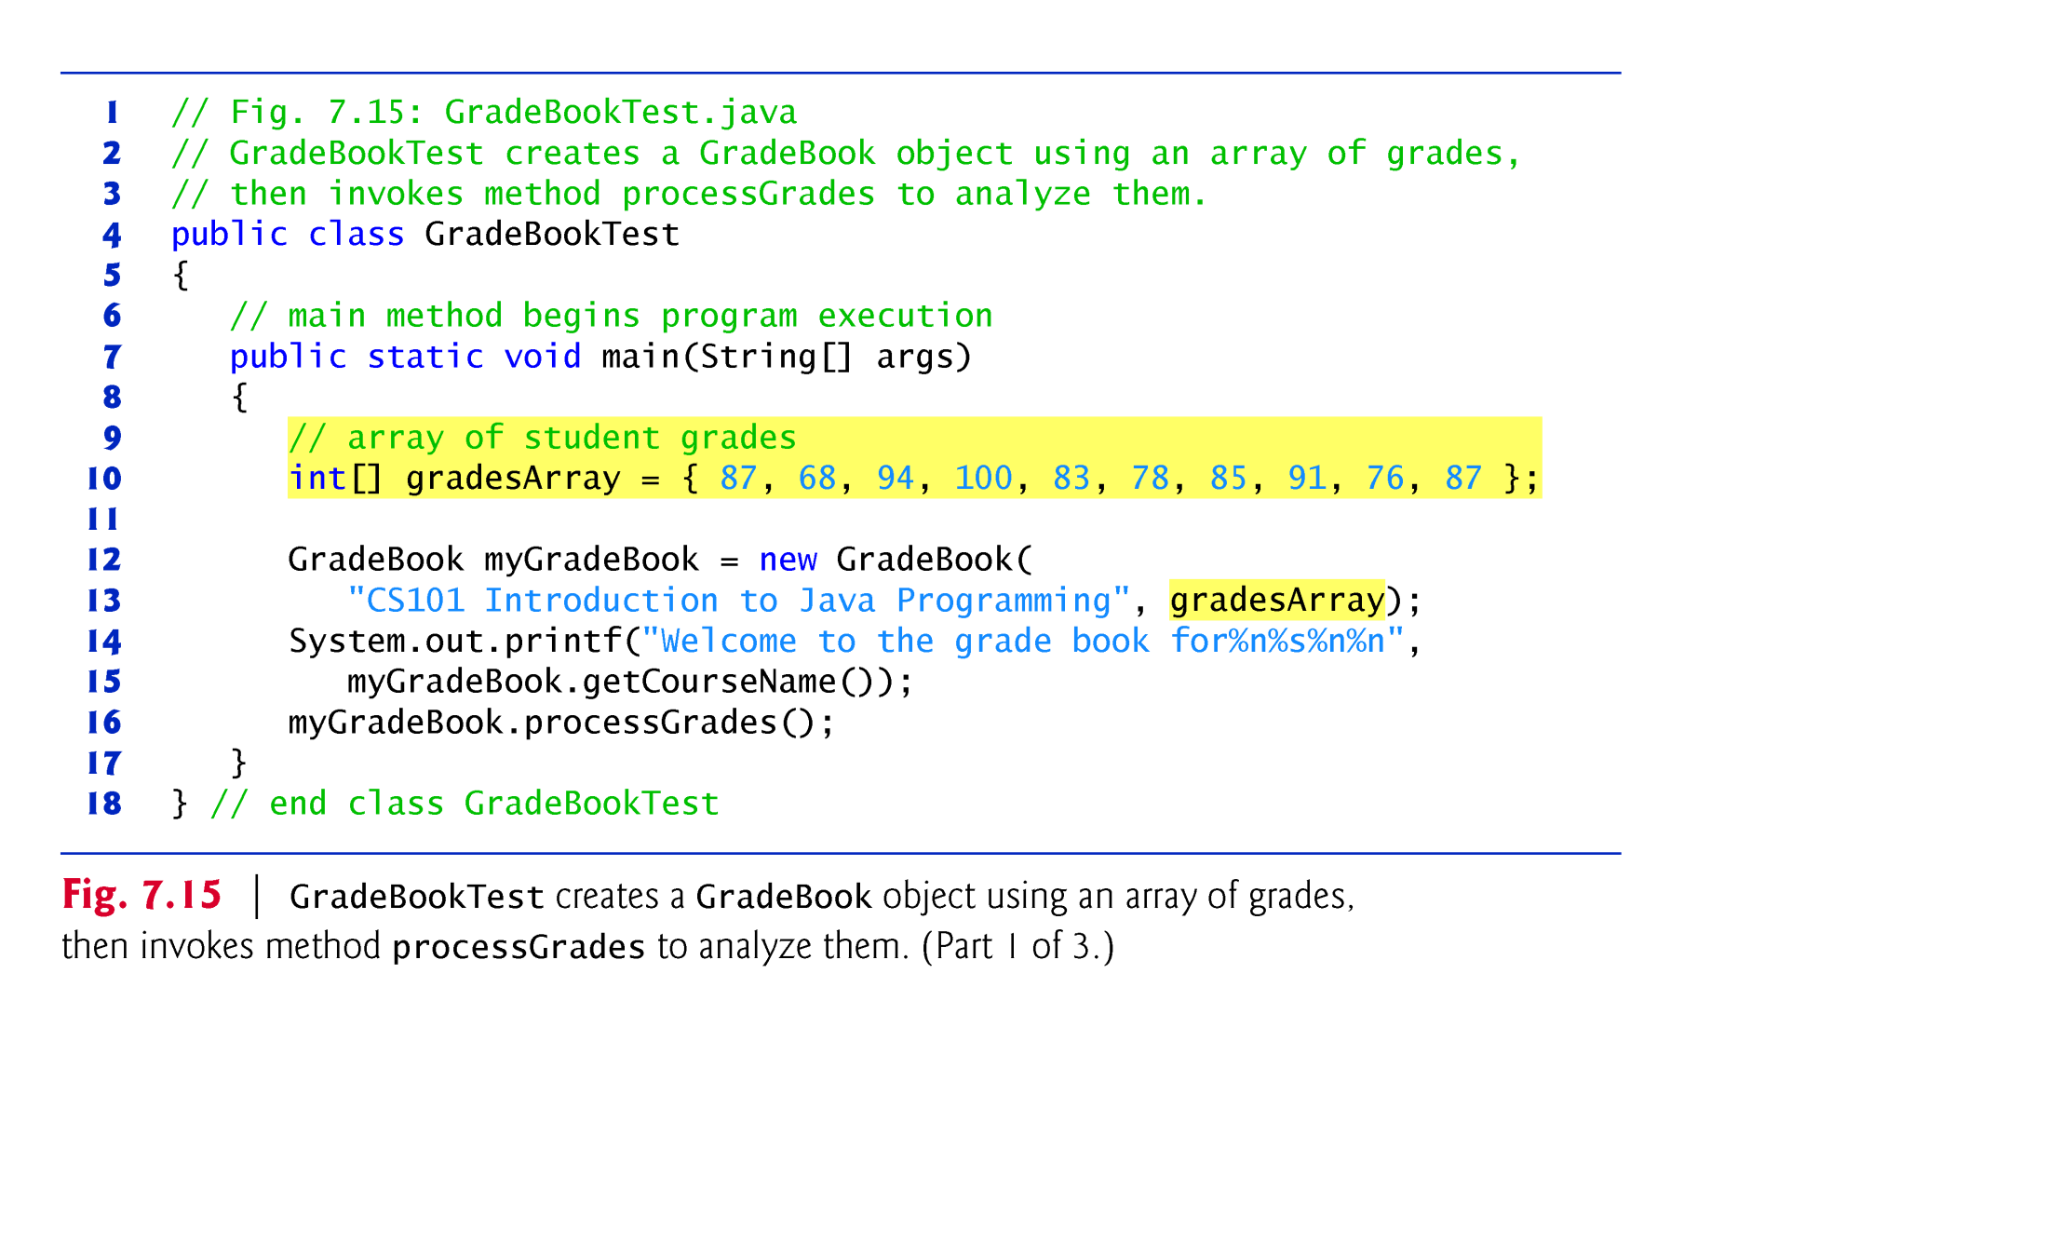

Slide 12
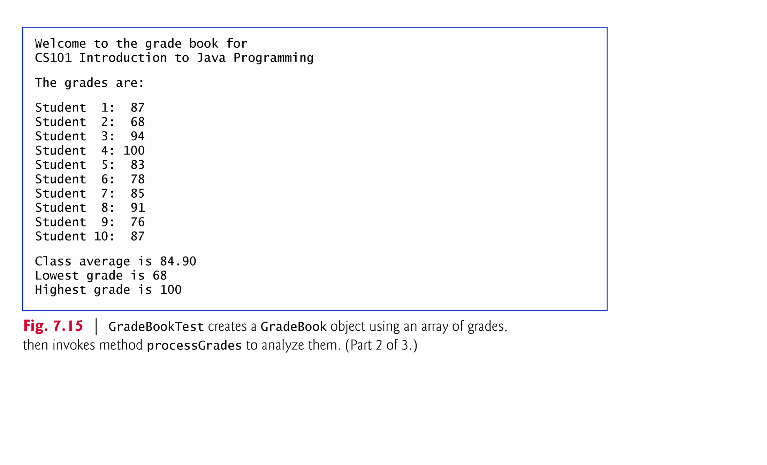

Slide 13
